Slide 1
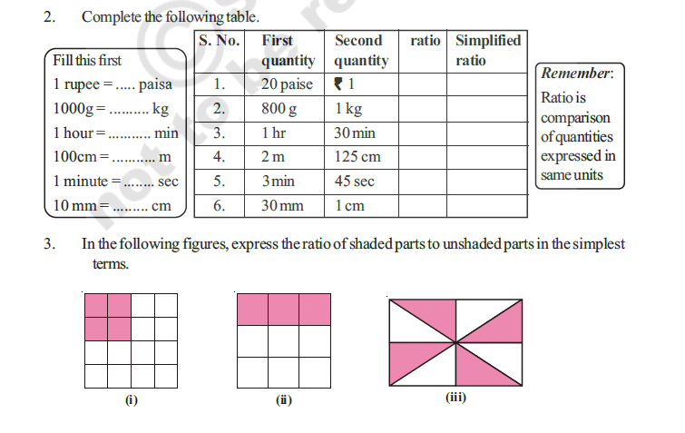
VI CLASS MATHEMATICS
152
3. Geetha and Laxmi won ` 1050 in a game. They agreed to share the amount in the ratio of
3:4. How much does each person receive?
4. Divide ` 3600 between Satya and Vishnu in the ratio of 3:5.
5. Two numbers are in the ratio 5:6. If the sum of the numbers is 132, find the two numbers.

Slide 2
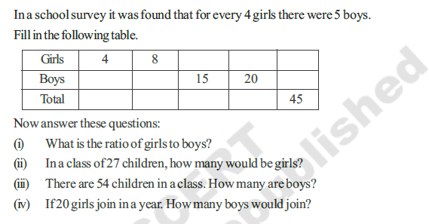
This whole exercise is activity. Change the numbers in the tables and questions? THEY DON’T NEED TO BE DYNAMIC AS THIS WILL BE AN ACTIVITY.
If we can program to change those numbers, we can do it.

